Slide 1

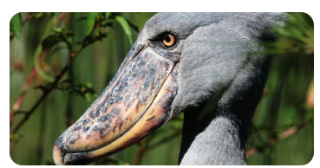
Bird Species Classification
https://www.kaggle.com/datasets/gpiosenka/100-bird-species
Problem Statement:
Nowadays, it has become a hobby of watching birds for human beings. Due to the different features of the bird with their color, size, and viewing angle of birds , humans are unable to identify and classify the bird species
Our project will helps to classify the bird species

Slide 2
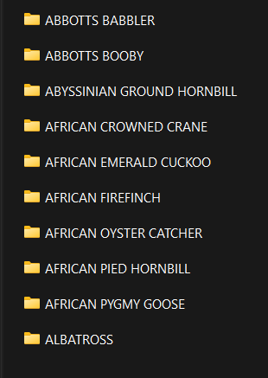
The Data-set contains of total 525 Bird-Species
Considered only 10 bird species
To reduce the Training time

Slide 3

Work-Flow Diagram:-
Data Collection
Data
Pre-Processing
Start
Collecting the
required dataset
for training and testing
the data undergoes pre-processing to compatible with
VGG-16 Model
Importing required
Libraries
Includes imaze image resizing , normalization of pixel values and data augementation like croping & rotation

Slide 4
Feature
Extraction
Apply CNN
preprocessed data is
set into CNN Model
CNN model extracts
features from different layers
It consists of CNN layers,
feature extraction modules

Slide 5
o/p &
Accuracy
Training
Testing
Evaluation of
trained model
Feeding labelled
data into model
Predicting Species classification
Loss Function-
Categorical Crossentropy
And calculating the Accuracy
Optimizer-Adam

Slide 6
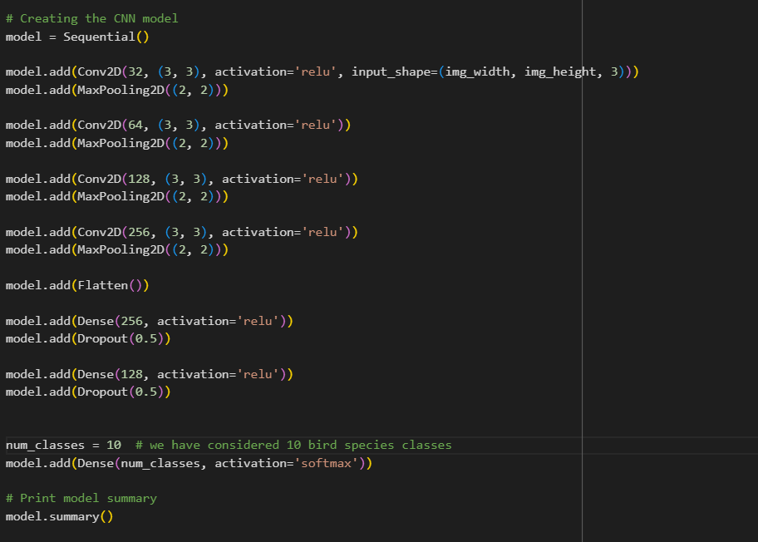
CNN Model used:-
4 CNN layers
3 Fully Connected Layers

Slide 7
CNN Architecture:-
FCL
FCL
FCL
CNN Layer
CNN Layer
CNN Layer
Max. Pooling
Max. Pooling
Max. Pooling
CNN Layer
Max. Pooling
Soft max.

Slide 8
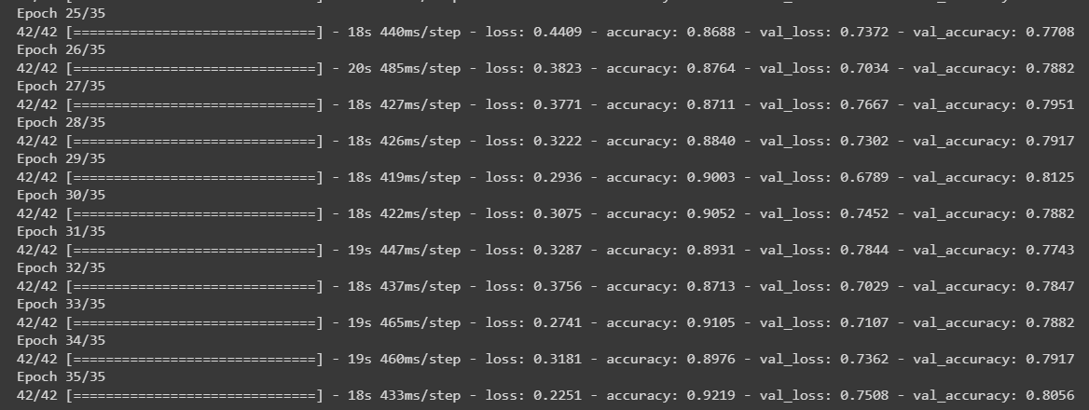
Accuracy:-
We got 92% train acc. And 80% valid acc.
And this is the max accuracy we for 35 epchos after several executions

Slide 9
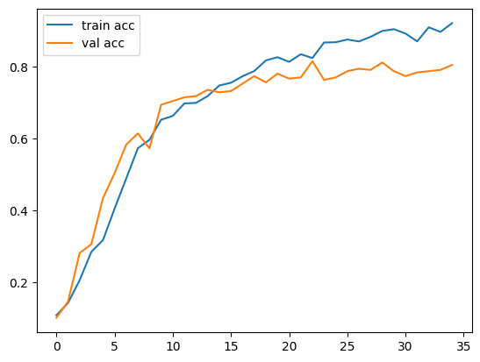
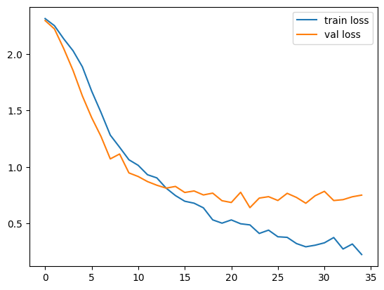
Train vs Vald. Accuracy:-
Train vs Vald. Loss:-

Slide 10
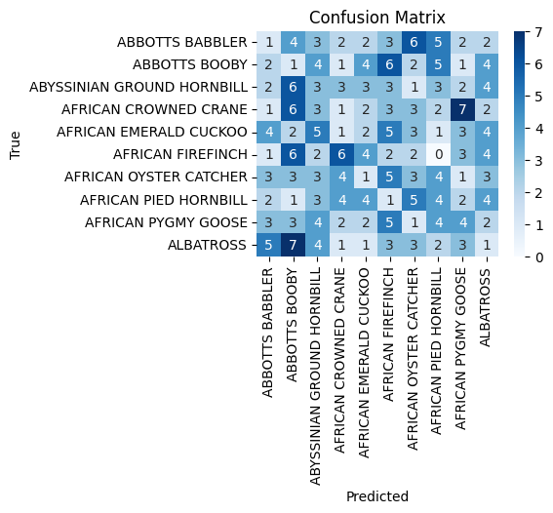
Confusion Matrix:-

Slide 11
Comparision:-

Slide 12
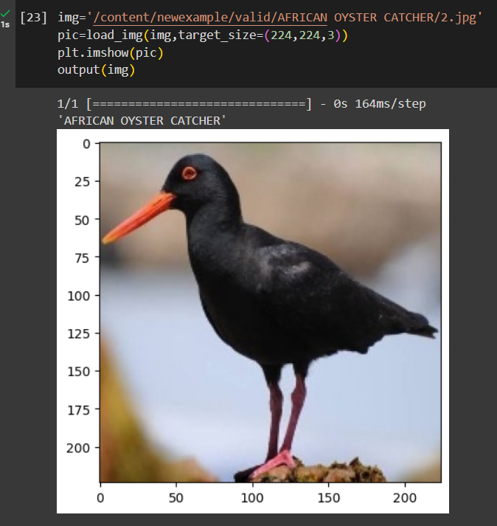
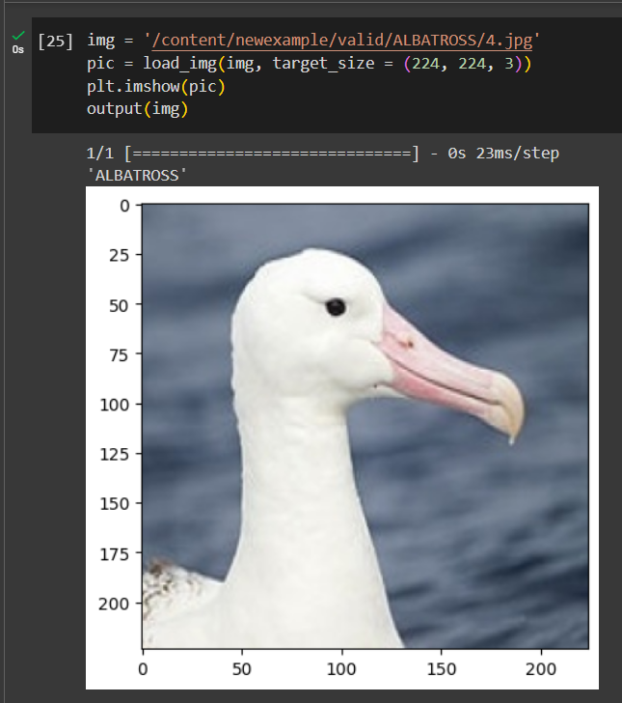
Predicting the species of Birds:-

Slide 13
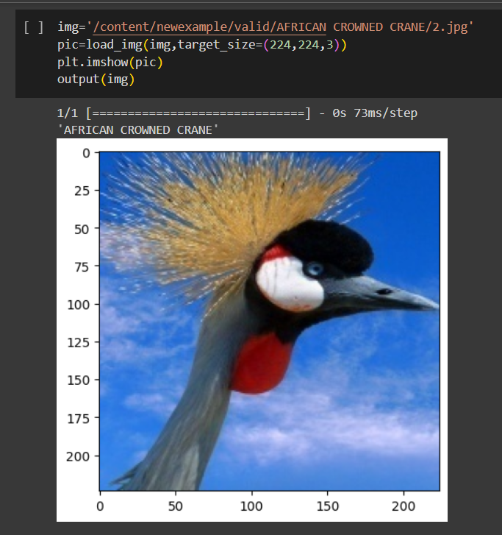
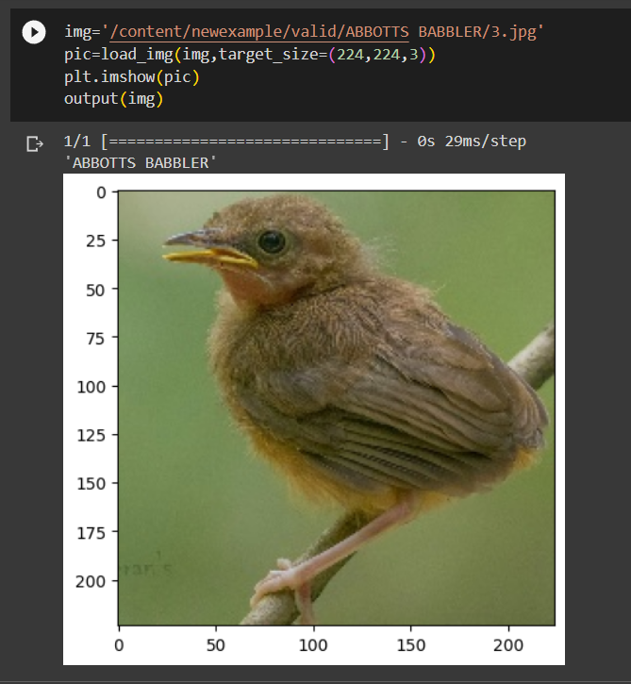
Predicting the species of Birds:-
THE END

